Slide 1
The Lean User Persona Template

Slide 2
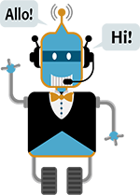
What is a persona?
A persona is a design tool that helps you write conversations. Before you can write a dialog, you have to have a clear picture of who is communicating. A good persona evokes a distinct tone and personality, and it’s simple enough to keep top-of-mind when writing dialog. It should be easy to answer the question: “What would this persona say or do in this situation?”.
Users will project a persona onto your assistant whether you plan for one or not. So it's in your best interest to purposefully design the experience you want users to perceive, instead of leaving it up to chance.
⚠ The goal of creating a persona is not to trick the user into thinking they're talking to a human being, but simply to leverage the communication system users learned first and know best: conversation. ⚠

Slide 3
Lean Persona Best Practices
If possible, draw from existing user research.
Don’t focus on a person’s likes and dislikes. Their tasks, behaviors, and goals are much more actionable to a product team.
Create a new persona only when you see significant differences in behaviors. Too many personas leads to convoluted design. Most products are well-served with 3-5 personas (7 max).
Leave out extraneous personal information if it’s unrelated to the problem. For example, if you design enterprise software, no need to mention the person’s favorite TV shows.
Lean personas are living documents. Ask for feedback from all stakeholders, then iterate. Test your prototype, then iterate based on new user insights.
Circulate your persona with anyone who touches product. The value lies in collaborative insights, not the document tacked on a wall.

Slide 4
Facts Adam the AS-02 admin - Adam has been an admin for 3 years Supports senior management and a team of 15 Bilingual Frequently engages the NSD on behalf of his clients | Pain Points Feels unreliable when caught in the middle of clients and service desk, waiting for resolution. Undefined processes, lack of internal knowledge. Spends too much time seeking out information from silos. Spends too much time on hold with NSD phone line.
Tasks & Behavior Makes software request on behalf of clients Makes hardware request, often bypassing NSD due to cumbersome process, and going right to the source Gathers information on requests on behalf of clients and management | Goals Speedy service for his clients Consistent methods to search, understand and gather process information Be more self sufficient

Slide 5
Facts Susan CS-03 Technical Team Lead - Has 20 years of technical and supervisory experience in the department Has joined and is leading her current team for the last 1 year Spends time managing projects, managing clients expectations, technical issues and supervisory roles | Pain Points Inability to procure tools the team needs in a timely manner Unable to navigate processes and search up relevant organizational information in a consistent manner
Tasks & Behavior Supervising team of new and old staff Provides training, guidance and career development Manages Kanban board Interacts directly with clients, gathering requirements and facilitation of certain issues | Goals Meet their service level agreements Better communication and client response times Transparent process

Slide 6
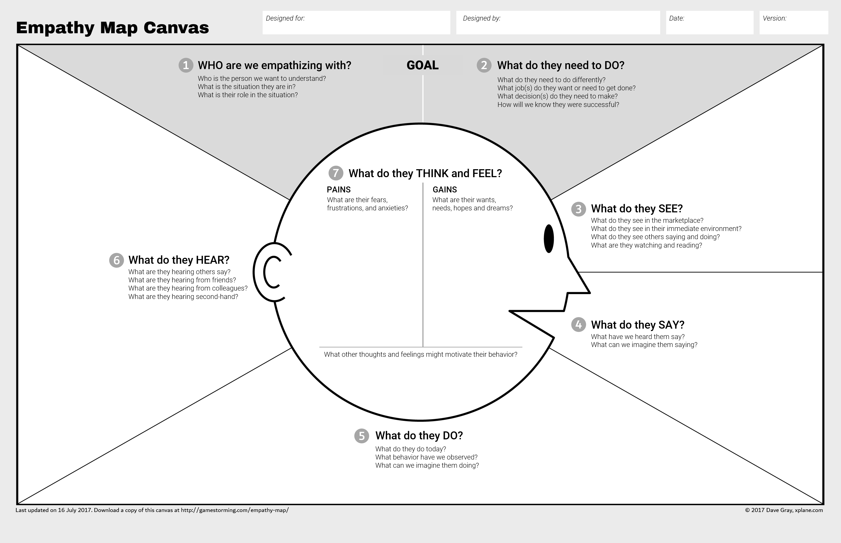
Adam
Often a middle-man between clients, management and NSD
Get back to their client/manager with a resolution
People are always running around the floor looking for answers
Peers have similar issues.
People are constantly asking for help with similar topics
Process change and lack of communication leaves him uninformed
Consistency
Process and deliverable are often out of their control and authority
Efficiency
Old ticketing system that is hard to navigate.
Improved client experience
Before I call the NSD I always try going to the source instead of opening a ticket because it takes too long.
Why do I have to call or submit a
generic email for any sort of help?
Receives inconsistent information from peers
Why does it take so long to get a response?
Why did they close my ticket without saying anything?
Goes to the source to solve a problem in lieu of
Timely (expected?) resolution when possible
Juggling requirements and priorities from a variety of teams
Frequently checks in on status of tickets
Submit requests and wait for a response.

Slide 7
Susan
Success based on client satisfaction
Meet their SLA
Technical person, knows what they need.
They require more consistency in making requests
Peers complaining about long responses – “I’m still waiting” said the client
Not much has changed in the last decade internally.
Consistency
Efficiency
Credibility
Wait times
Deadlines, milestones missed due to ticket response times
Much more advanced technology in
the private sector
Why are we so far behind?
No corporate push to improve things
I’m not even going to bother with a ticket, I’ll just
Go ask their team lead in person
Why do others get things faster?
Avoid opening tickets at all cost and only
When necessary
Spends time waiting for ticket resolution,
Frequently following to manage client/staff expectations
Try to fix it themselves

Slide 8
Alfred’s Persona
(steps taken from google design guidelines)
Step﻿ 1
Brainstorm a list of adjectives (e.g., friendly, technologically competent). Focus on the qualities you want users to perceive when talking to your Action.
Step﻿ 2
Narrow your list down to 4-6 key adjectives that describe your persona’s core personality traits.
Step﻿ 3
Come up with a few different characters who embody these qualities (e.g., a barista, a fashion icon, a world traveler). Your persona doesn’t have to be a person. It could also be an anthropomorphized animal, an alien, an artificial intelligence, a cartoon character, etc.
Step﻿ 4
Choose one character that best embodies your Action and write a short description, no more than a paragraph. This description should provide a clear sense of what this persona is like, especially what it would say, write, or do.
Focus on personality traits, and avoid specifying things like gender or age because they almost never critically define or differentiate a persona. Furthermore, deciding the gender upfront will make it harder to find the right voice, since you’ve already eliminated half of the options.
Step﻿ 5
Find, or create, an image or two that visually represents your persona. Pictures are a great memory aid and can help you keep the persona in mind when writing dialog. If you create your own, consider using it as your Action’s logo so users can see it too.

Slide 9
Alfred | Adjectives ---
Chatacters --- | Description

